Slide 1
EUROPEAN DIGITAL PORTFOLIO FOR UNIVERSITY STUDENTS
European Digital Portfolio for University Students
“The e-Portfolio for all University Students in Europe”
This project is supported by the EU. Any communication or publication related to the Project made by the beneficiaries jointly or individually in any form and using any means, shall indicate that it reflects only the author's view and that the NA and the Commission are not responsible for any use that may be made of the information it contains.

Slide 2
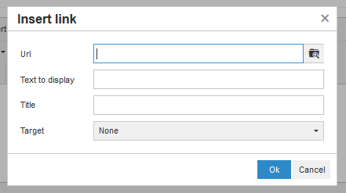
B10. The file manager
Files play a major role to the creation of your profile
DISCLAIMER: EDIPUS Does not store any files or images you upload.
All files are stored to your personal Google Drive
You can manage your files on your GD even outside the EDIPUS
This project is supported by the EU. Any communication or publication related to the Project made by the beneficiaries jointly or individually in any form and using any means, shall indicate that it reflects only the author's view and that the NA and the Commission are not responsible for any use that may be made of the information it contains.

Slide 3
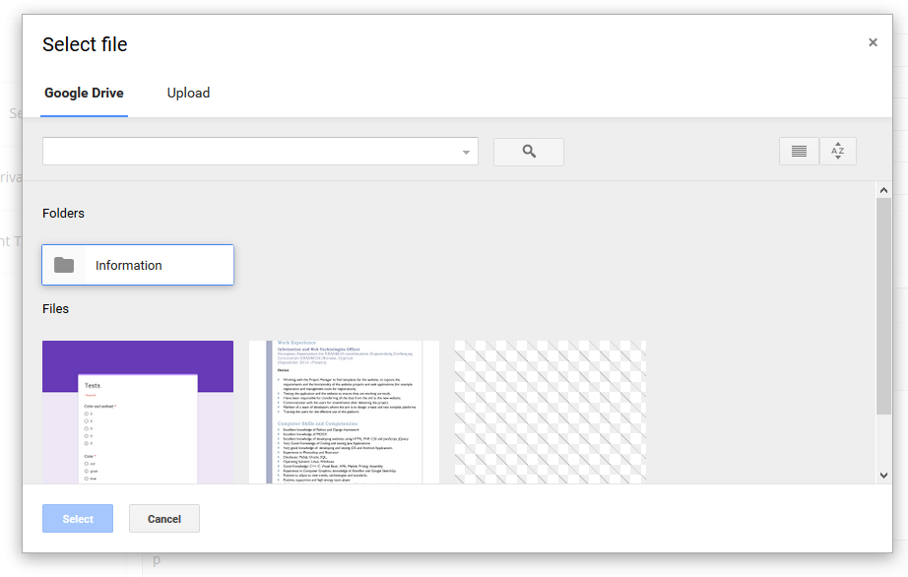
B10. The file manager
This project is supported by the EU. Any communication or publication related to the Project made by the beneficiaries jointly or individually in any form and using any means, shall indicate that it reflects only the author's view and that the NA and the Commission are not responsible for any use that may be made of the information it contains.

Slide 4
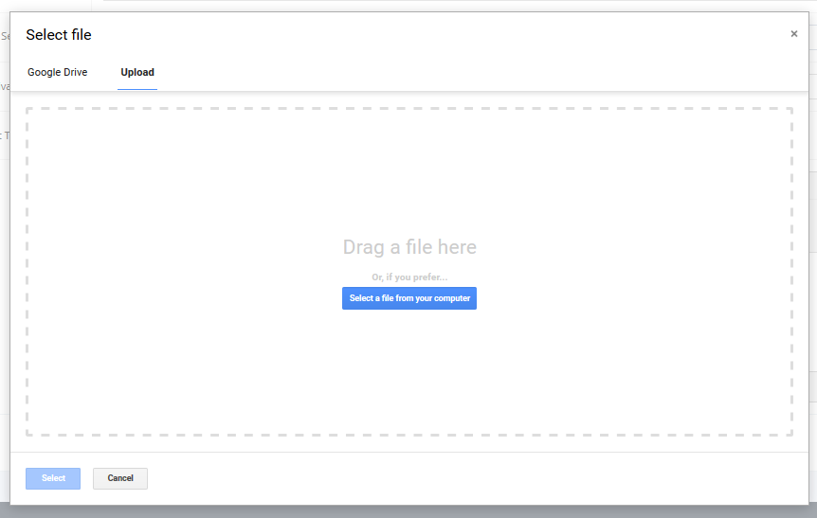
B10. The file manager
This project is supported by the EU. Any communication or publication related to the Project made by the beneficiaries jointly or individually in any form and using any means, shall indicate that it reflects only the author's view and that the NA and the Commission are not responsible for any use that may be made of the information it contains.

